Slide 1
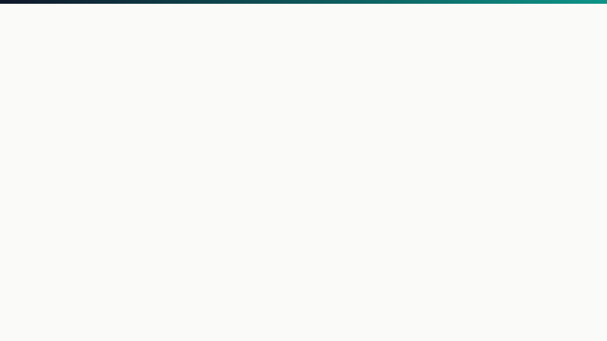


ARGUS
Advanced Real-Time Exam Supervision Engine
Name : Ashish Roy Shayon
Roll : 245433
Supervisor : Dr. Ahmedul Kabir

Slide 2
Project Description
"Because cheating shouldn't be easier than studying."
Argus is a high-performance network monitor engineered to eliminate digital examination loopholes with absolute zero network latency.
Native OS Integration: Operates directly at the packet layer using raw sockets.
Advanced Inspection: Bypasses standard application-layer limitations and simple DNS filters.
Threat Neutralization: Defeats hidden encrypted VPN tunnels and proxy chains.
Anti-Tampering: Systematically prevents local OS clock manipulation.
SOFTWARE PROJECT LAB 1
PAGE 2

Slide 3
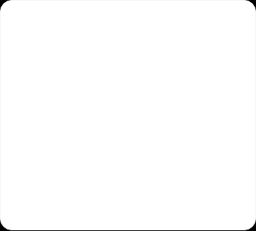
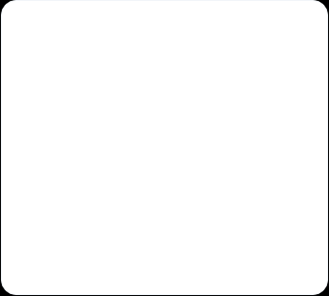



Motivation
The Problem
The Vulnerability
The Solution
Basic DNS filtering is highly vulnerable. Students easily bypass these measures using proxy chains and standard circumvention tools during exams.
Undetected encrypted VPN tunnels and local OS clock tampering entirely compromise the integrity of digital examinations across the network.
A robust, low-level Deep Packet Inspection (DPI) engine designed to ensure fundamentally fair and secure environments for honest students.
SOFTWARE PROJECT LAB 1
PAGE 3

Slide 4







System Workflow
1. Capture
2. Parse
3. Extract
4. Enforce
5. Drop
Intercepts traffic silently at native OS layer via raw sockets.
Strips Ethernet, IP, and TCP headers mathematically in-memory.
Parses TLS Client Hello handshake for Server Name Indication.
Evaluates parsed hostname via an Aho-Corasick Automaton.
Proactively drops and logs unauthorized data packets.
SOFTWARE PROJECT LAB 1
PAGE 4

Slide 5
Core System Features
Deep Packet Inspection: Bypasses DNS filtering by extracting Server Name Indication from TLS handshakes prior to encryption.
VPN Detection: Analyzes payload randomness using Shannon Entropy to identify tunnels without data decryption.
Hybrid Cryptography: Secures telemetry tunnel using a robust mix of asymmetric (RSA) and symmetric (RC4/XOR) encryption.
Multiplexed Dashboard: Single-threaded architecture asynchronously monitoring students via an ImGui/OpenGL interface.
Precision Anti-Tamper: Syncs clients with a trusted server time, actively defeating local OS clock manipulation.
Data Compression: Huffman Coding shrinks violation logs to fit strictly within the 512-byte binary protocol limit.
SOFTWARE PROJECT LAB 1
PAGE 5

Slide 6
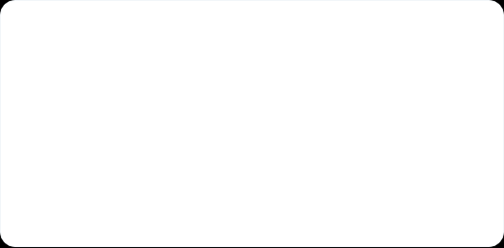
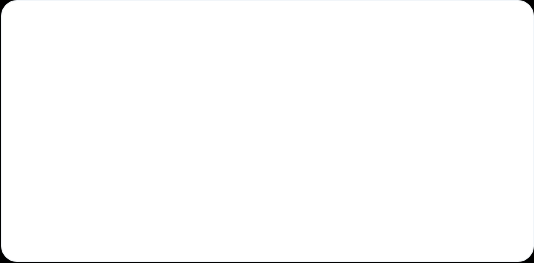







The Algorithmic Engine
Rivest-Shamir-Adleman (RSA)
Shannon Entropy
A widely used asymmetric (public-key) cryptographic method developed in 1977, essential for securing online data transmission
Identifies VPNs via payload randomness. Encrypted blocks yield entropy approaching 8.0.
Cristian's Algorithm
Huffman Coding
Synchronizes client/server time dynamically to calculate offsets and defeat local clock tampering.
Prefix-free variable-length encoding generated via a Min-Heap frequency tree to compress 512-byte payload limits securely without data loss.
SOFTWARE PROJECT LAB 1
PAGE 6

Slide 7







Technology Stack
Core Engine
Supervision UI
Version Control
Written entirely in high-performance C++17. Utilizes strict packet-level network control via libpcap and native raw sockets.
Renders a lightweight, responsive, and hardware-accelerated dashboard interface utilizing Dear ImGui, GLFW, and OpenGL 3.2+.
Strict source code versioning, branch management, and collaborative integration managed via Git and hosted securely on GitHub.
SOFTWARE PROJECT LAB 1
PAGE 7

Slide 8

Thank You
https://github.com/DevNexus09/Argus-ExamSupervisonSystem.git

